Slide 1

Artificial Intelligence and Machine Learning
Classification

Slide 2
Lecture 2: Outline
Linear Regression (Review)
Intro to Classification
Logistic Regression (Linear Classifier)
Classification Metrics
Other ML Models
Optimizers

Slide 3
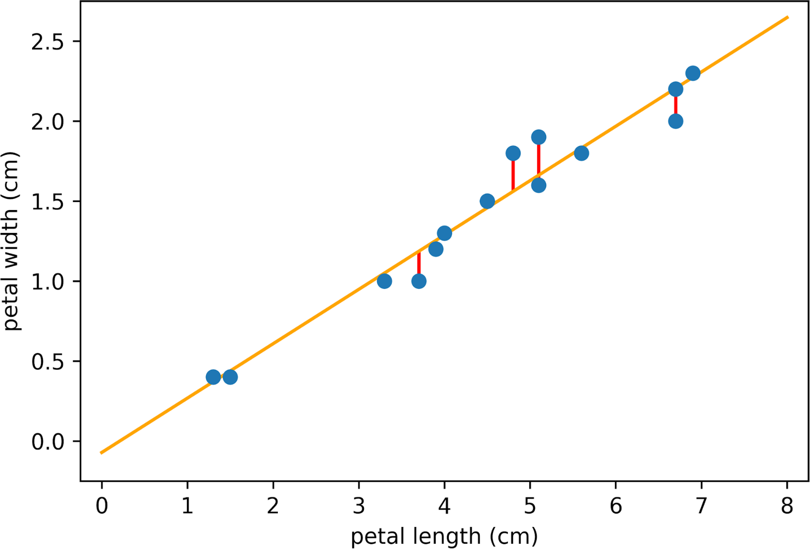
Recap
Design your model
Input scalar linear model (line fitting)
Fitting polynomials (synthetically designing features from a one-dimensional input)
Design your loss function
We used mean squared error loss throughout
Finding optimal parameter fitting
Closed form solution to the linear least squares?
Why is it linear least squares?
Solution is closed form

Slide 4
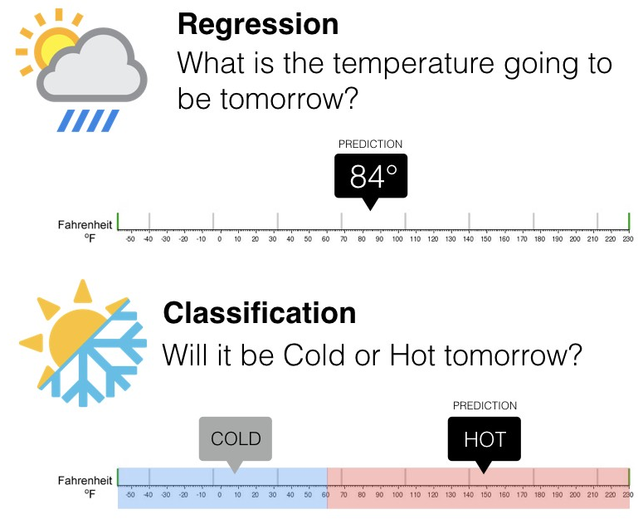
Regression VS classification
=> Continuous Values
=> Discrete Values

Slide 5
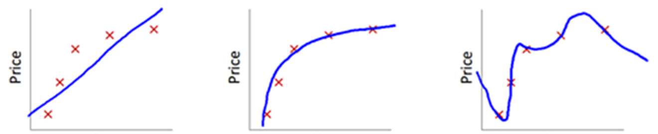
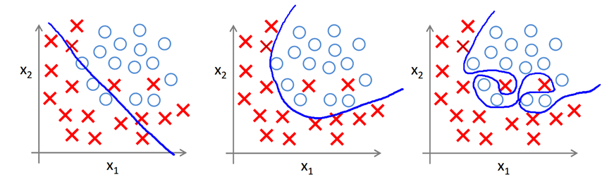
Regression VS classification
Regression:
Linear Polynomial Very complex (overfitting)
Classification:
Linear Polynomial Very complex (overfitting)

Slide 6

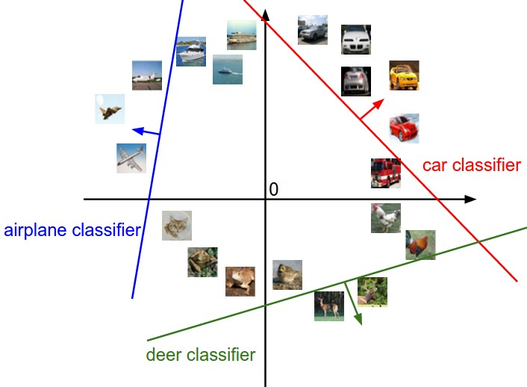
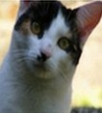
Interpreting a Linear Classifier
[32x32x3]
array of numbers 0...1
(3072 numbers total)

Slide 7
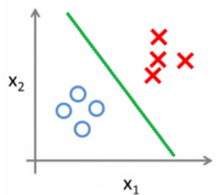
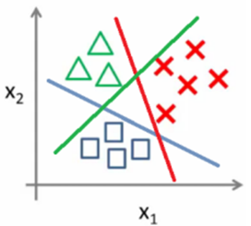
Classification Types
Binary Classification: Two possible outcomes (e.g., Yes/No, Spam/Not Spam).
How? Single Classifier.
Multiclass Classification: More than two outcomes (e.g., Class A, B, C).
How? Multiple *Single Classifiers*.

Slide 8
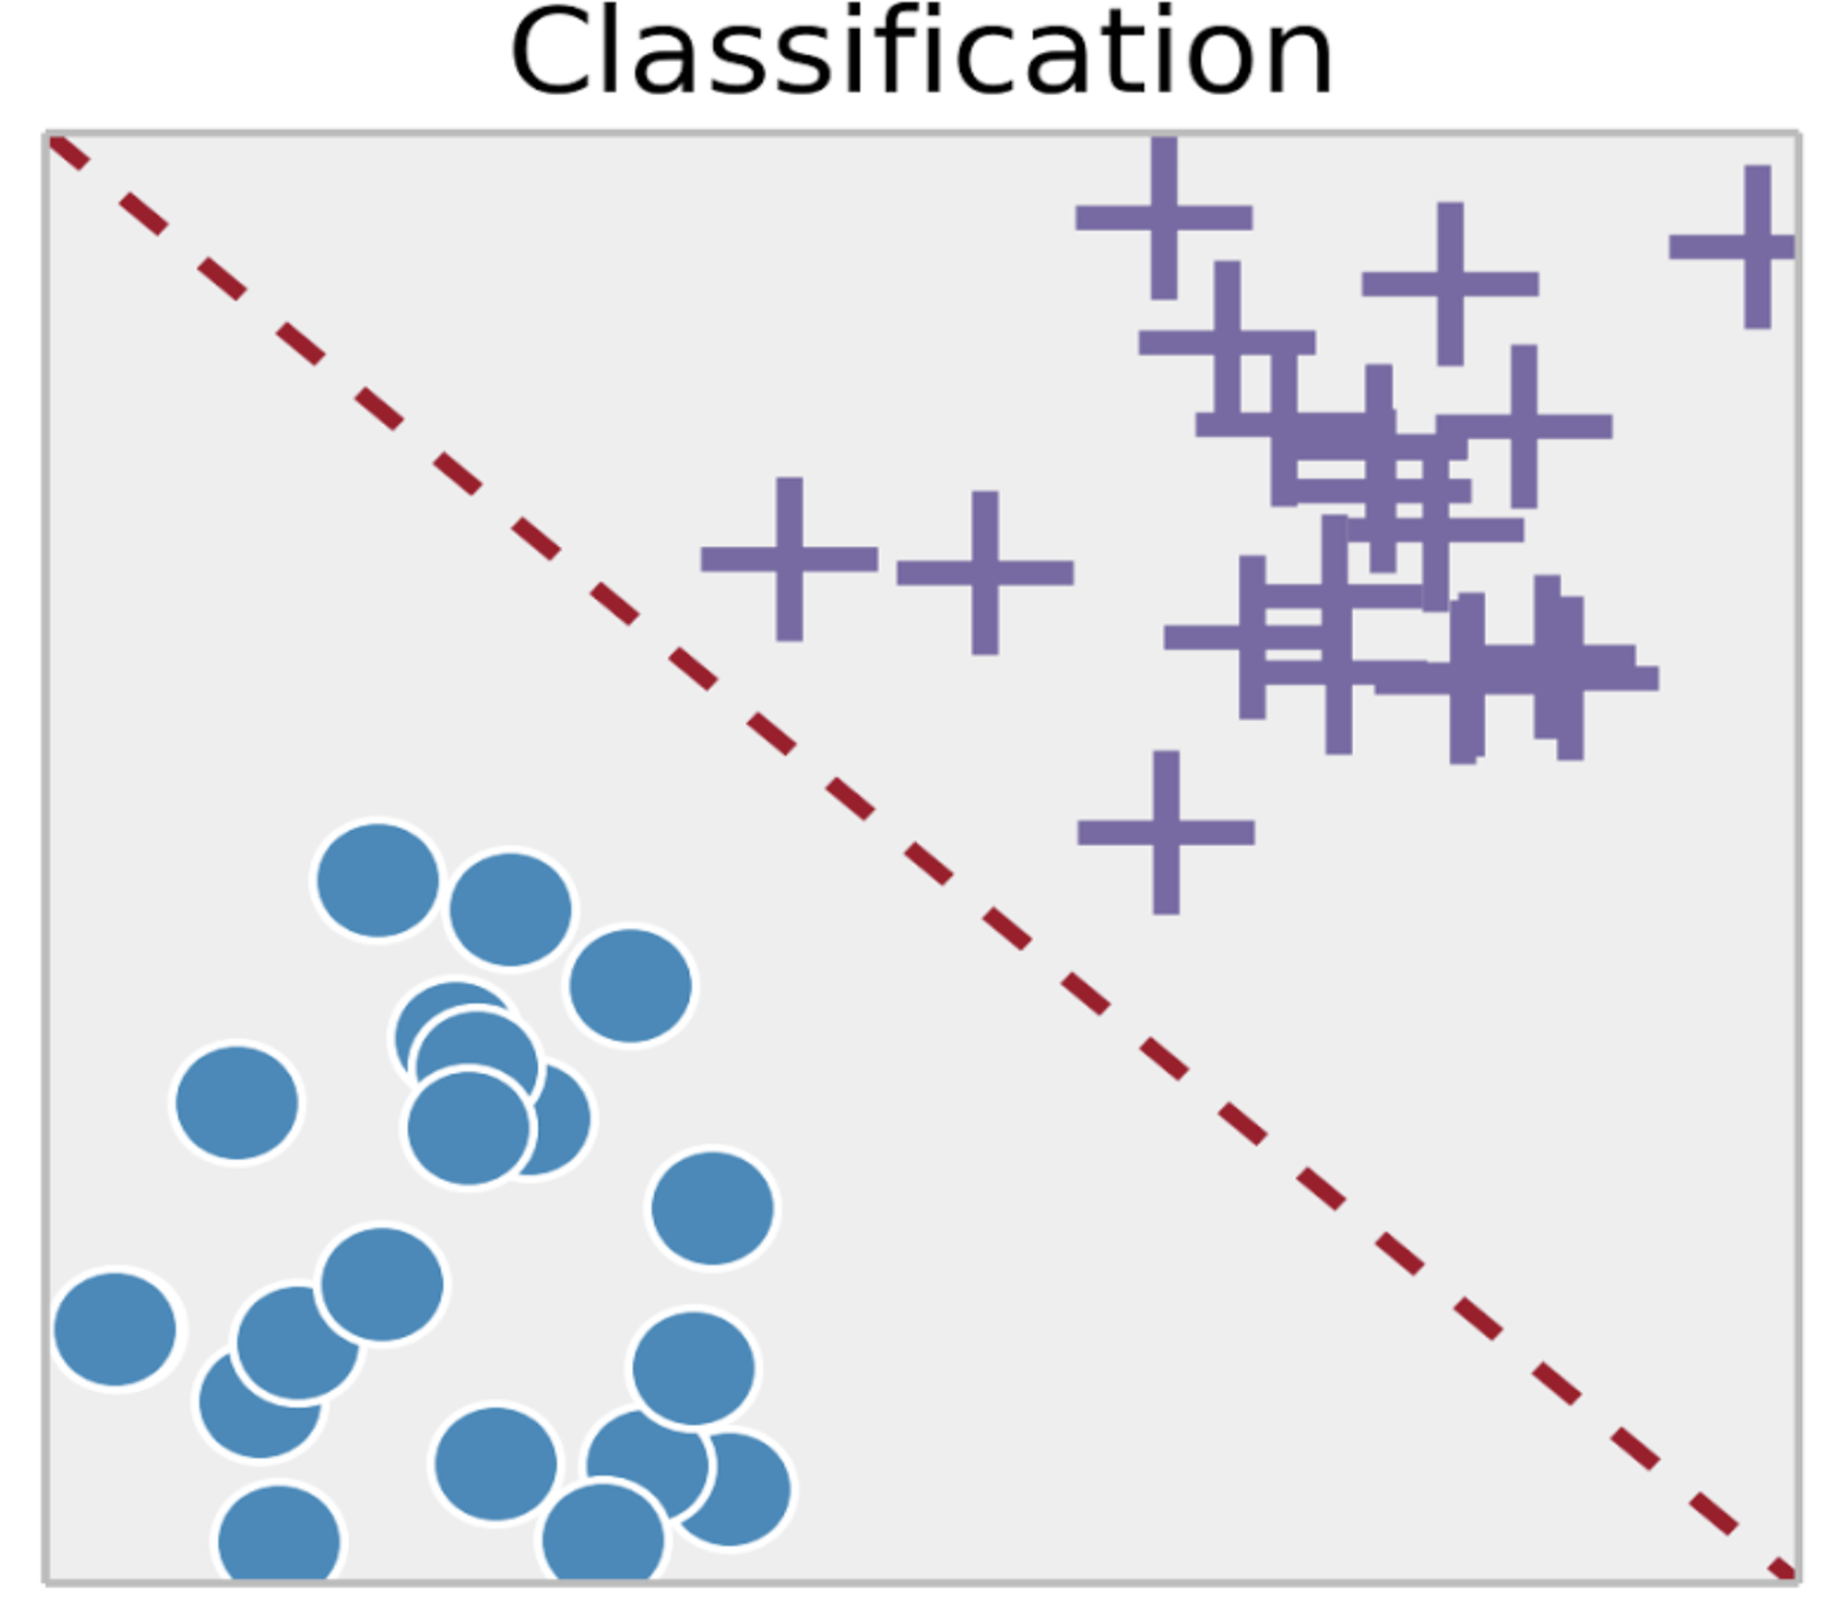
Linear Model in Disguise

Slide 9

Linear Model in Disguise
Recall that the output/label y is binary
How to map the predictions to binary?

Slide 10
Linear Classifier
The linear classifier we will study is basically a regression model with two key modifications:
Pass the regression outputs through a special function to convert them into probabilities.
Replace the Mean Squared Error loss with a new loss function designed for probabilities.
Applying these two to the Linear Regression should give Linear Classifier (called Logistic Regression).

Slide 11
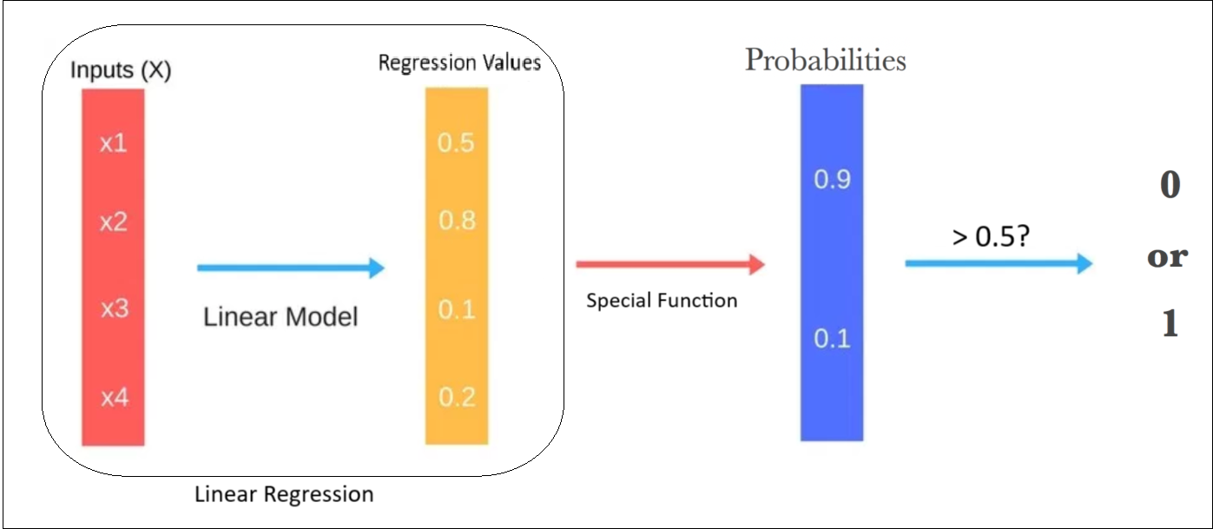
Logistic Regression

Slide 12
Special Function
We are searching for a function that has the following characteristics:
Could convert any arbitrary input values to [0,1] range (Probabilities).
Smooth and Differentiable. Because we want to find the minima later, right?
Any ideas?

Slide 13
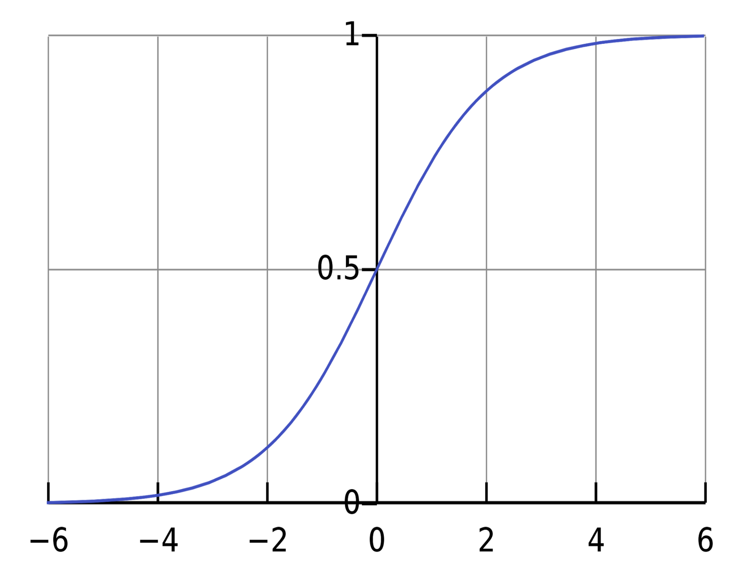
Sigmoid Function (for Binary Classification)
$$σ^{′}\left(z\right)=σ\left(z\right)(1−σ\left(z\right))$$
Assuming you have negative and positive classes, its output would be the probability of the positive class.
But what if we have multiclass problem?🤔
Notes:
\sigma(z) = \frac{1}{1+exp(-z)}
\lim_{z \to \infty} \sigma (z) =0

Slide 14
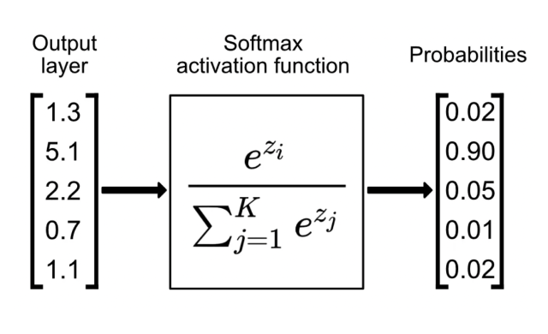

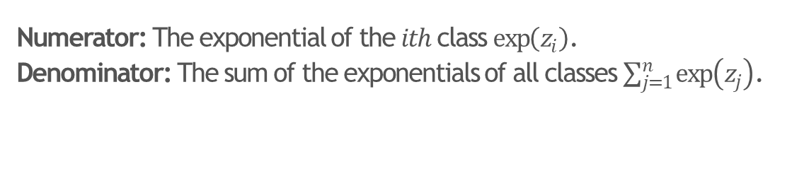
Softmax Function (for Multiclass Classification)
$$Softmax\left(z_{i}\right)=\frac{\exp\left(z_{i}\right)}{\sum_{j=1}^{n}{\exp\left(z_{j}\right)}}$$
Numerator: The exponential of the $ith$ class $\exp\left(z_{i}\right)$.
Denominator: The sum of the exponentials of all classes $\sum_{j=1}^{n}{\exp\left(z_{j}\right)}$.
E.g. Divide the cat value by the cat, dog and deer values to get the cat probability.
Assuming you have K classes, its output would be the probability of the ith class. So, you will run it K times to get the probability of each class.
Note: Sigmoid is a special case of Softmax. Optional: Can you prove it?
Notes:
\sigma(z) = \frac{1}{1+exp(-z)}
\lim_{z \to \infty} \sigma (z) =0

Slide 15
Classification Loss
We are searching for a loss that have the following characteristics:
Probabilistic behaviour: Should work with probabilities, not raw numbers.
Sensitivity: It should heavily penalize incorrect confident predictions (e.g., predicting 0.9 when the true label is 0).
Differentiable: Must be smooth and differentiable to enable optimization.
Any ideas?

Slide 16
Classification Loss
We are searching for a loss that have the following characteristics:
Probabilistic behaviour: Should work with probabilities, not raw numbers.
Sensitivity: It should heavily penalize incorrect confident predictions (e.g., predicting 0.9 when the true label is 0).
Differentiable: Must be smooth and differentiable to enable optimization.
Any ideas?
Logarithm is all you need :)

Slide 17
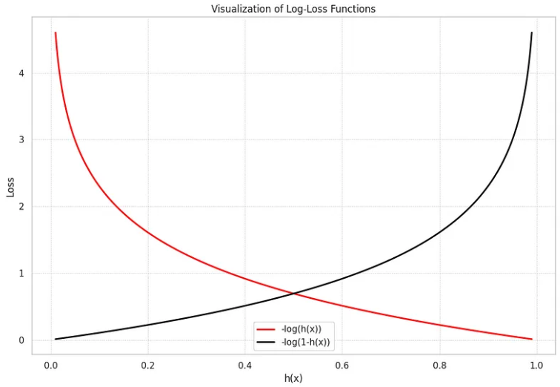
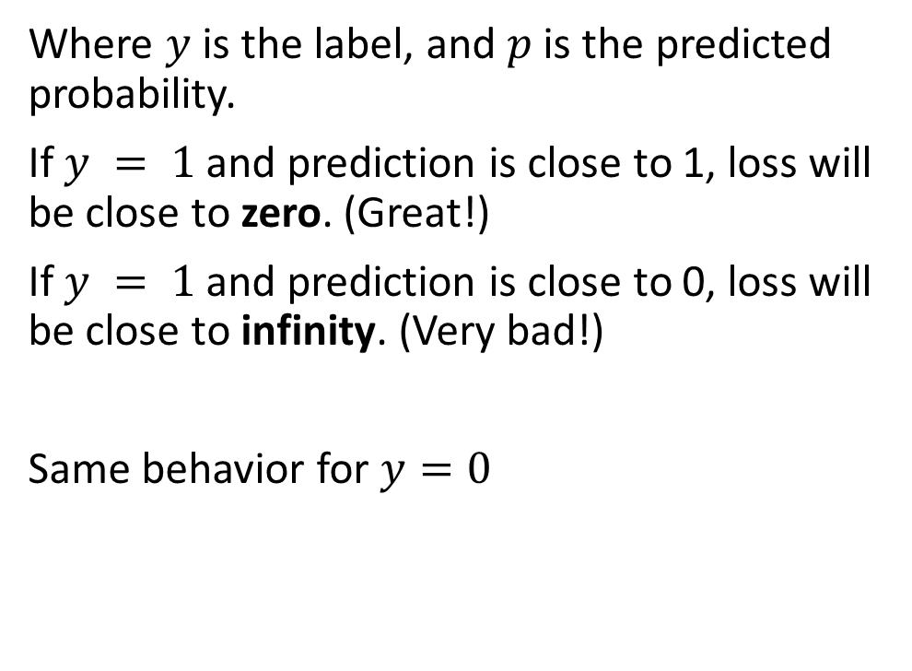
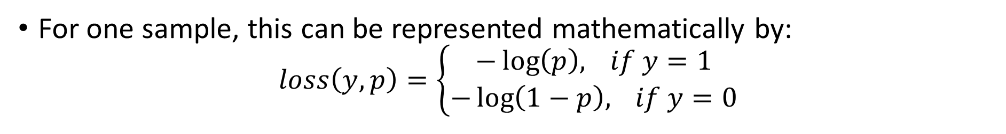
Binary Cross Entropy (LogLoss)
For one sample, this can be represented mathematically by:
$$loss\left(y,p\right)=\left\{\begin{aligned}−\log\left(p\right), if y=1 \\ −\log\left(1−p\right), if y=0\end{aligned}\right.$$
Where $y$ is the label, and $p$ is the predicted probability.
If $y = 1$ and prediction is close to 1, loss will be close to zero. (Great!)
If $y = 1$ and prediction is close to 0, loss will be close to infinity. (Very bad!)
Same behavior for $y=0$

Slide 18
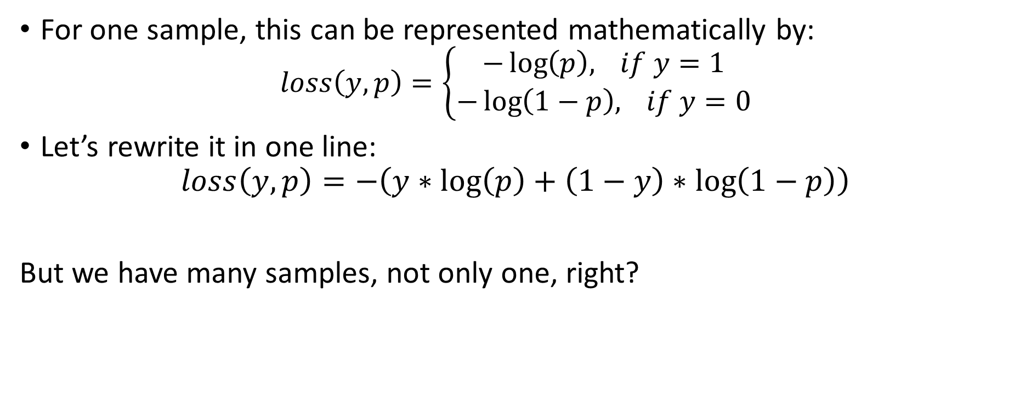
Binary Cross Entropy (LogLoss)
For one sample, this can be represented mathematically by:
$$loss\left(y,p\right)=\left\{\begin{aligned}−\log\left(p\right), if y=1 \\ −\log\left(1−p\right), if y=0\end{aligned}\right.$$
Let’s rewrite it in one line:
$$loss\left(y,p\right)=−\left(y∗\log\left(p\right)+\left(1−y\right)∗\log\left(1−p\right)\right)$$
But we have many samples, not only one, right?

Slide 19

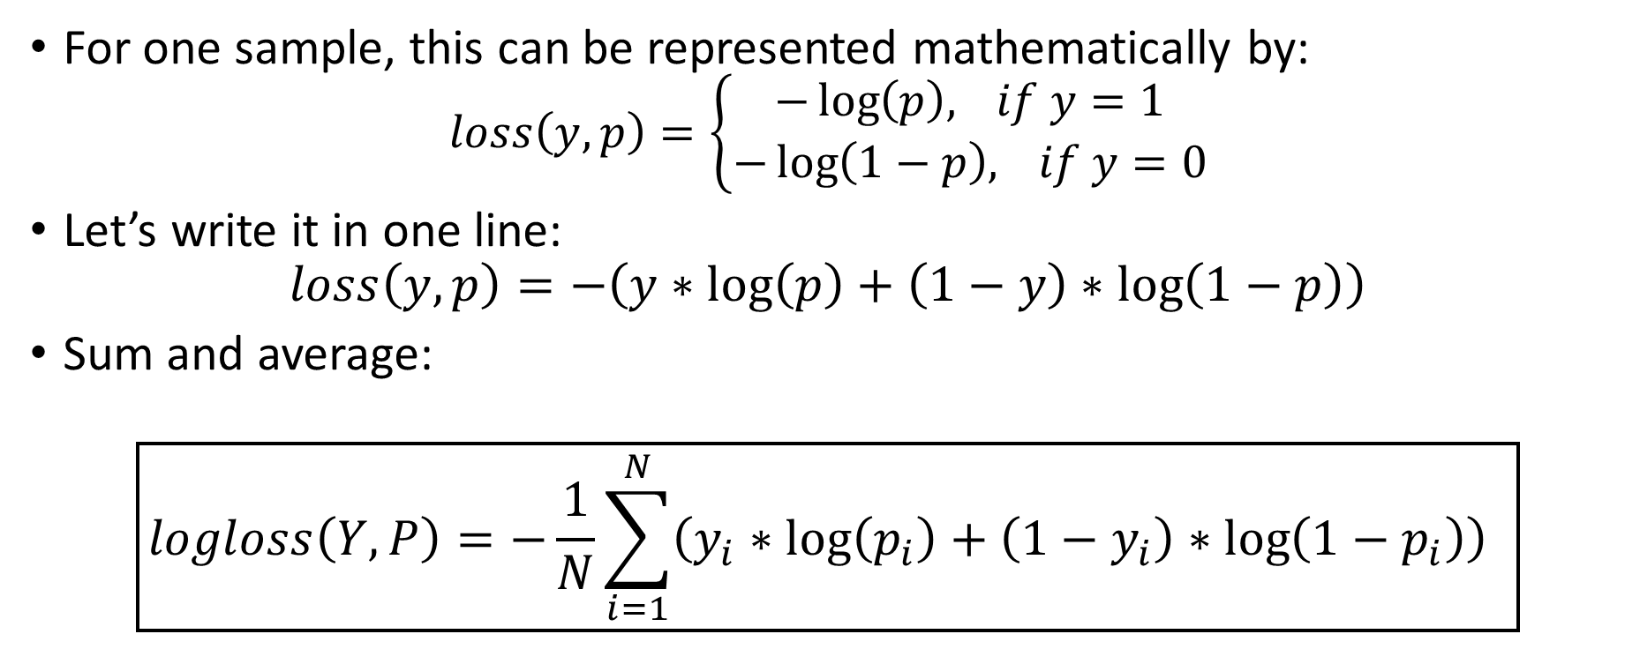
Binary Cross Entropy (LogLoss)
For one sample, this can be represented mathematically by:
$$loss\left(y,p\right)=\left\{\begin{aligned}−\log\left(p\right), if y=1 \\ −\log\left(1−p\right), if y=0\end{aligned}\right.$$
Let’s write it in one line:
$$loss\left(y,p\right)=−\left(y∗\log\left(p\right)+\left(1−y\right)∗\log\left(1−p\right)\right)$$
Sum and average:
$$\boxed{logloss\left(Y,P\right)=−\frac{1}{N}\sum_{i=1}^{N}{\left(y_{i}∗\log\left(p_{i}\right)+\left(1−y_{i}\right)∗\log\left(1−p_{i}\right)\right)} }$$
$Y$: Represents the true labels.
$P$: Represents the predicted probabilities for the positive class.

Slide 20
How to find optimal Parameters?
Just like before, simply take
However, this does not have a nice closed solution, unlike the MSE case

Slide 21
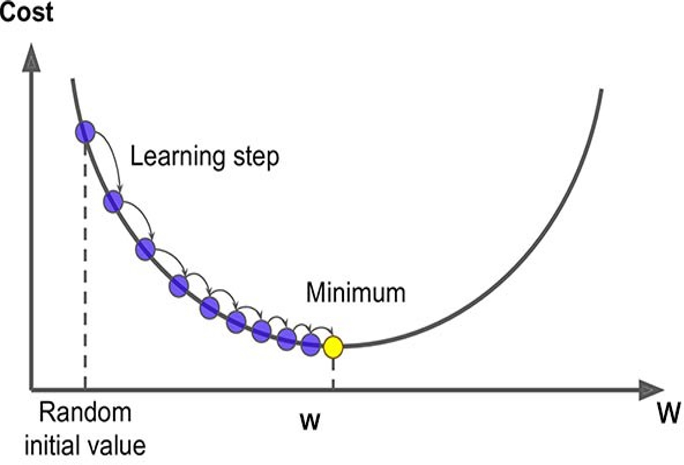
How to find optimal Parameters?
Just like before, simply take
However, this does not have a nice closed solution unlike the MSE case
Instead, use gradient descent (optimizer)!
Learning rate
Notes:
\mathbf{w}^{k+1} = \mathbf{w}^{k}- \eta\nabla_{\mathbf{w}}J(\mathbf{w}^k)

Slide 22
Logistic Regression
Learning rate
We have a linear model for prediction
For classification, we want to output a probability
We map the prediction to probabilities with a sigmoid function
We have a loss function (BCE) to compare models

Slide 23
Logistic Regression
Linear Regression | Logistic Regression
For Regression | For Classification
We predict the target value for any input value | We predict the probability that the input value belongs to the specific target
Target: Real Values | Target: Discrete values
Graph: Straight Line | Graph: S-curve

Slide 24

Classification Metrics
Accuracy:
Accuracy measures the proportion of correctly classified samples out of the total number of samples.
Question: Why not optimizing for the accuracy directly instead of using LogLoss?
$$Accuracy=\frac{Correct Samples}{All Sample}$$

Slide 25

Classification Metrics
Accuracy:
Accuracy measures the proportion of correctly classified samples out of the total number of samples.
Question: Why not optimizing for the accuracy directly instead of using LogLoss?
Non-differentiable
$$Accuracy=\frac{Correct Samples}{All Samples}$$

Slide 26
Classification Metrics
Accuracy:
Accuracy measures the proportion of correctly classified samples out of the total number of samples.
Question: Why not optimizing for the accuracy directly instead of using LogLoss?
Non-differentiable
$$Accuracy=\frac{Correct Samples}{All Sample}$$
Could also be written as:
$$Accuracy=\frac{TP+TN}{TP+TN+FP+FN}$$
Where:
TP: True Positives
TN: True Negatives
FP: False Positives
FN: False Negatives

Slide 27
Classification Metrics
But accuracy isn’t always enough!
Imagine an imbalanced dataset with 95% negative labels (e.g., "not spam").
A model predicting "negative" all the time will be 95% accurate but useless.

Slide 28
Classification Metrics
Different goals require different metrics
Do you care more about catching all positives (e.g., cancer detection)?
Or avoiding false alarms (e.g., fraud detection)?
But accuracy isn’t always enough!
Imagine an imbalanced dataset with 95% negative labels (e.g., "not spam").
A model predicting "negative" all the time will be 95% accurate but useless.

Slide 29
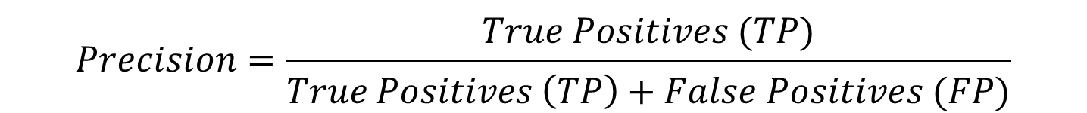
Classification Metrics
Precision:
Among all the positive predictions the model made, how many are actually correct?
important when minimizing false alarms is critical, like in fraud detection or spam filtering.
$$Precision=\frac{True Positives (TP)}{True Positives \left(TP\right)+False Positives (FP)}$$

Slide 30
Classification Metrics
Recall:
Among all the actual positives, how many did the model correctly identify?
important when catching all positives is vital, such as in cancer detection.
$$Recall=\frac{True Positives (TP)}{True Positives \left(TP\right)+False Negatives (FN)}$$

Slide 31

Classification Metrics
F1 Score:
What if both precision and recall are important?
Take their (harmonic) mean.
$$F1 score=\frac{2}{\frac{1}{Precision}+\frac{1}{Recall}}$$

Slide 32
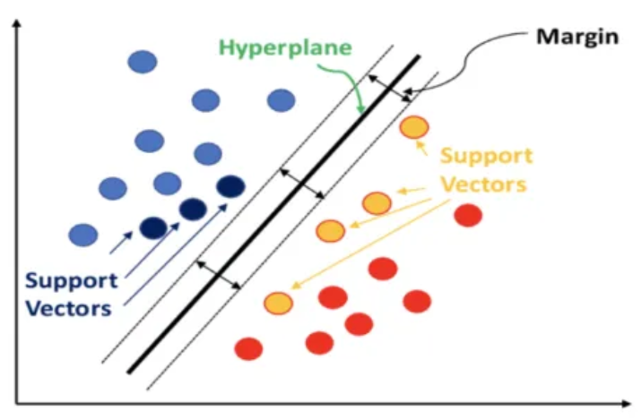
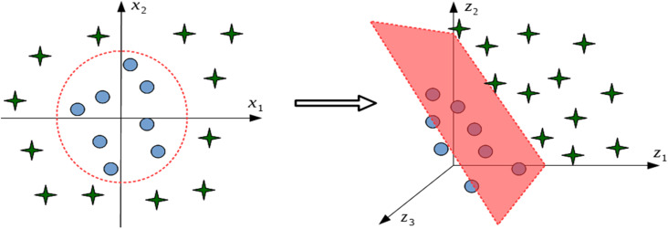
Other ML Models
Support Vector Machine (SVM):
Key Idea:
SVM finds the best boundary (hyperplane) that separates classes by maximizing the margin between them.
Works well with high-dimensional data and small datasets.
Can be computationally expensive for large datasets.

Slide 33
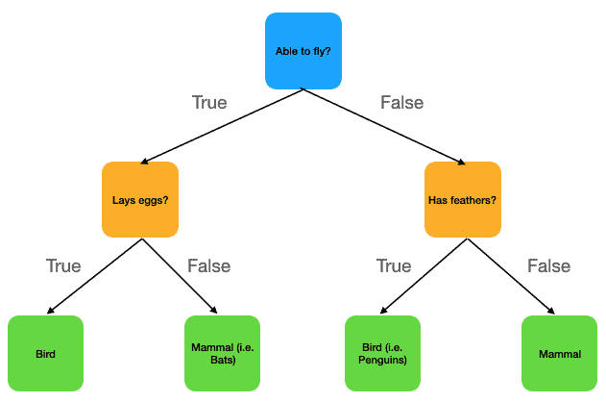
Other ML Models
Decision Trees:
Key Idea:
A tree-based model splits data into subsets based on feature thresholds, creating a flowchart-like structure for decision-making.
Overfits very easily.
could work bad if relation between features and the target is linear. (Check the right figure)

Slide 34
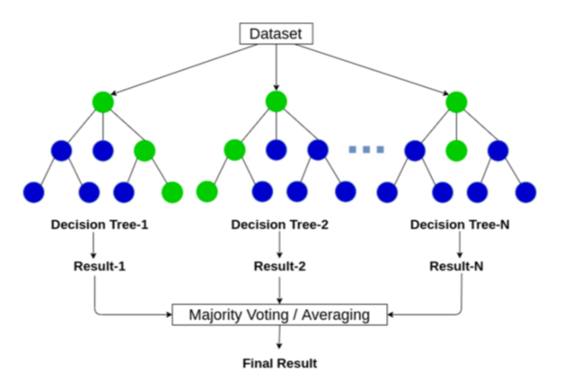
Other ML Models
Random Forest:
Instead of training one tree, let’s train a forest :)
Key Idea:
Training K decision trees independently, where each one is fed with a different subset of samples and features.
Then average the results (Regression) or Take the mode (Classification).
Powerful model.

Slide 35
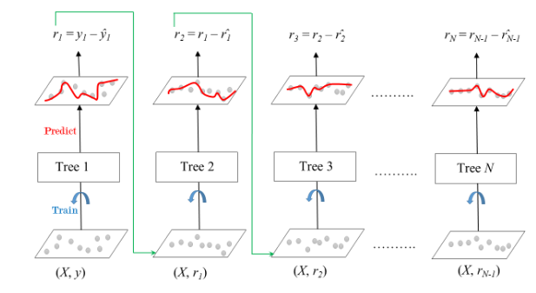
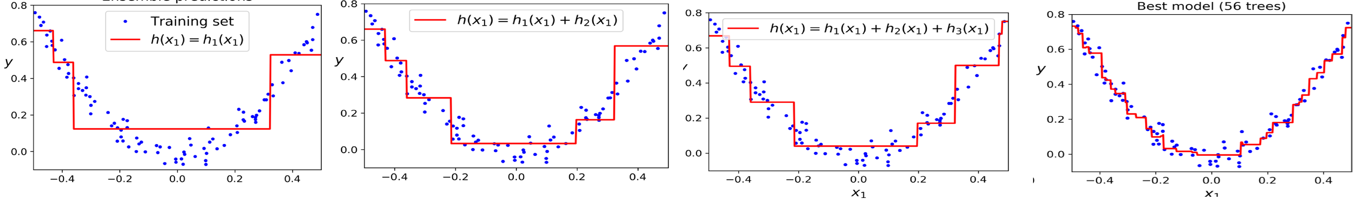
Other ML Models
Gradient Boosting:
Key Idea:
Training K decision trees dependently, where each tree corrects the errors of the previous one.
Many versions: XGBoost, LightGBM, CatBoost,…etc
Top ML models.

Slide 36
A Slight Detour: A Look at Optimization Tools

Slide 37
Introduction
Optimizers are algorithms that adjust the weights of the model to minimize the loss function during training.
They are one of the main components of Deep Learning models.
We will go through several types of optimizers in this section.

Slide 38
Direction of maximum increase and decrease for a function
Gradient direction is the direction of maximum increase for a function
Negative gradient is the direction of maximum decrease for a function

Slide 39
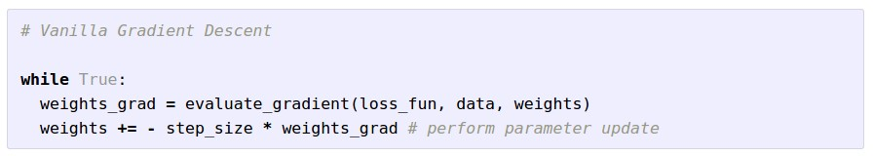
Gradient Descent

Slide 40
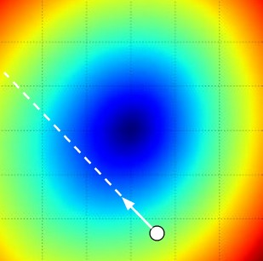
W_2
original W
W_1
negative gradient direction

Slide 41
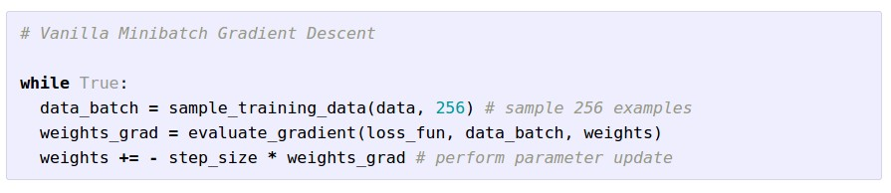
Mini-batch Gradient Descent
only use a small portion of the training set to compute the gradient.
Common mini-batch sizes are 32/64/128 examples
e.g. Krizhevsky ILSVRC ConvNet used 256 examples

Slide 42
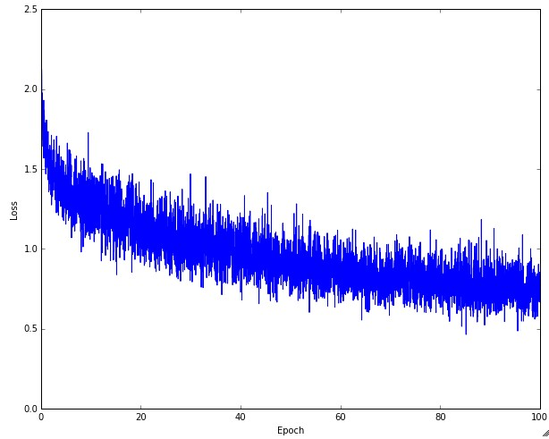
Example of optimization progress while training a neural network.
(Loss over mini-batches goes down over time.)

Slide 43
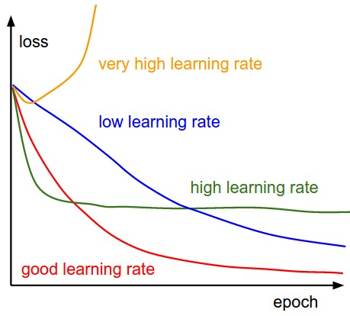
The effects of step size (or “learning rate”)

Slide 44
Mini-batch Gradient Descent
only use a small portion of the training set to compute the gradient.
we will look at more fancy update formulas
(momentum, Adagrad, RMSProp, Adam, …)
Common mini-batch sizes are 32/64/128 examples
e.g. Krizhevsky ILSVRC ConvNet used 256 examples

Slide 45
Minibatch updates
W_2
True negative gradient direction
W_1
original W
Slide based on CS294-129 by John Canny

Slide 46
Minibatch Gradient Descent
W_2
noisy gradient from minibatch
W_1
original W
Slide based on CS294-129 by John Canny

Slide 47
Minibatch Gradient Descent
W_2
True gradients in blue minibatch gradients in red
W_1
original W
Gradients are noisy but still make good progress on average
Slide based on CS294-129 by John Canny

Slide 48
You might be wondering…
W_2
Standard gradient
Can we compute this?
W_1
Slide based on CS294-129 by John Canny

Slide 49
Newton step
W_2
Standard gradient
Newton gradient step
W_1
Slide based on CS294-129 by John Canny

Slide 50

Newton’s method for gradients:
The Newton update is:
$$x_{n+1}= x_{n} − {H_{f}\left(x_{n}\right)}^{−1}∇f\left(x_{n}\right)$$
Where $H_{f}$ is the Hessian matrix of second derivatives of $f$.
Converges very fast, but rarely used in DL. Why?
Slide based on CS294-129 by John Canny

Slide 51
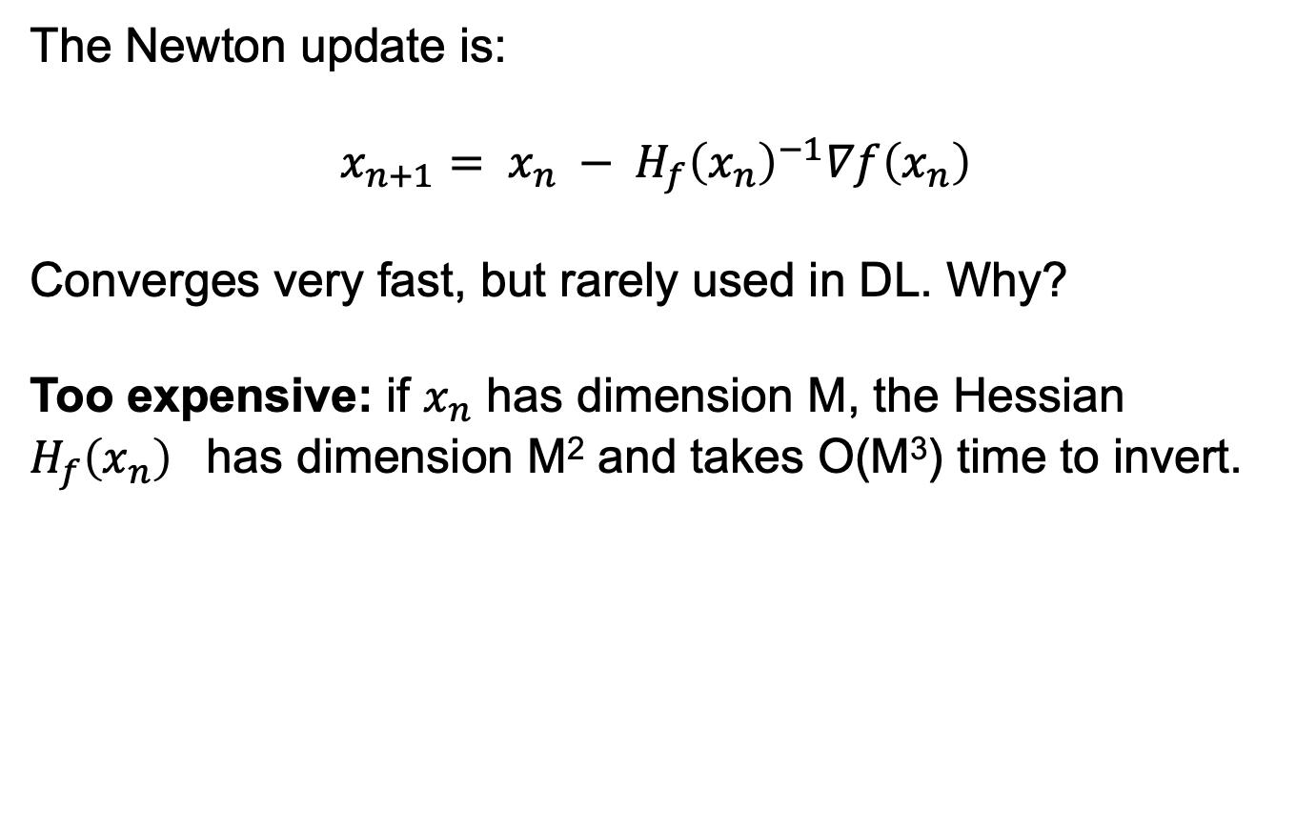
Newton’s method for gradients:
The Newton update is:
$$x_{n+1}= x_{n} − {H_{f}\left(x_{n}\right)}^{−1}∇f\left(x_{n}\right)$$
Converges very fast, but rarely used in DL. Why?
Too expensive: if $x_{n}$ has dimension M, the Hessian ${H_{f}\left(x_{n}\right)}^{}$has dimension M² and takes O(M³) time to invert.
Slide based on CS294-129 by John Canny

Slide 52
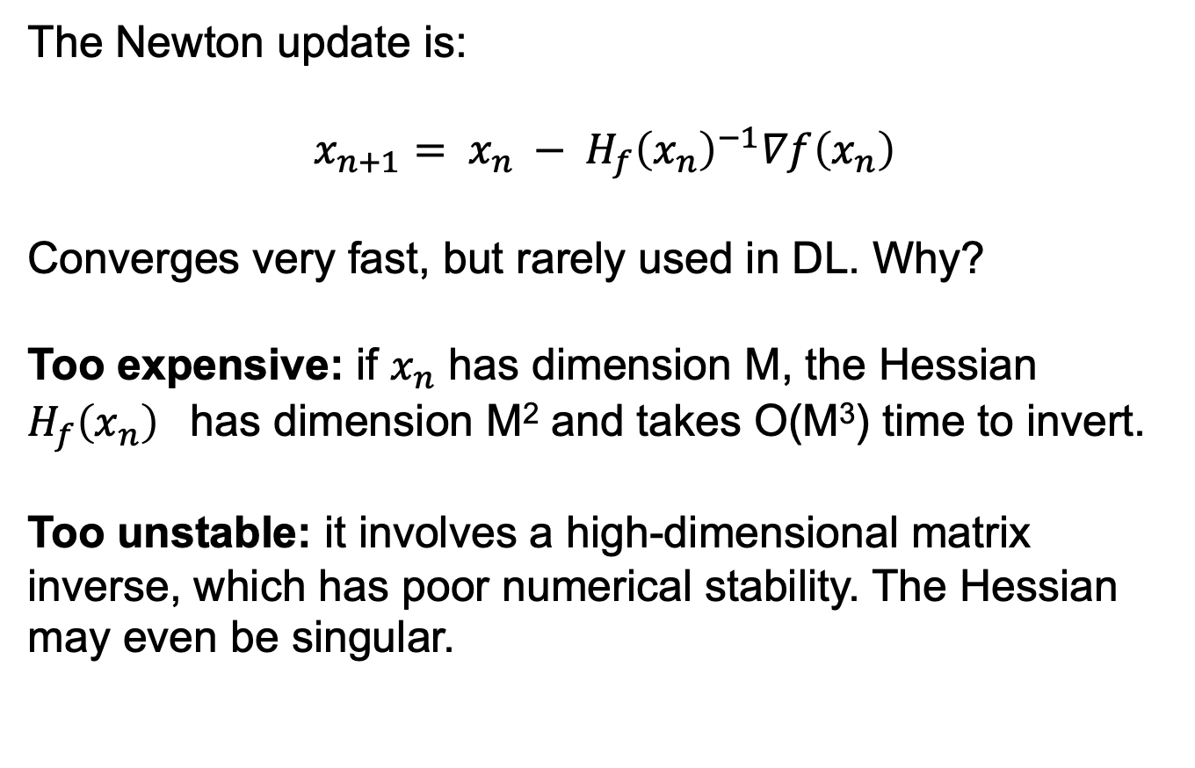
Newton’s method for gradients:
The Newton update is:
$$x_{n+1}= x_{n} − {H_{f}\left(x_{n}\right)}^{−1}∇f\left(x_{n}\right)$$
Converges very fast, but rarely used in DL. Why?
Too expensive: if $x_{n}$ has dimension M, the Hessian ${H_{f}\left(x_{n}\right)}^{}$has dimension M² and takes O(M³) time to invert.
Too unstable: it involves a high-dimensional matrix inverse, which has poor numerical stability. The Hessian may even be singular.
Slide based on CS294-129 by John Canny

Slide 53


Momentum update
- Physical interpretation as ball rolling down the loss function + friction (mu coefficient).
- mu = usually ~0.5, 0.9, or 0.99 (Sometimes annealed over time, e.g. from 0.5 -> 0.99)

Slide 54
Momentum update
Allows a velocity to “build up” along shallow directions
Velocity becomes damped in steep direction due to quickly changing sign

Slide 55
SGD
vs
Momentum
notice momentum
overshooting the target, but overall getting to the minimum much faster than vanilla SGD.

Slide 56

AdaGrad update
[Duchi et al., 2011]
Added element-wise scaling of the gradient based on the historical sum of squares in each dimension

Slide 57
AdaGrad update
Q: What happens with AdaGrad?

Slide 58
AdaGrad update
Q2: What happens to the step size over long time?

Slide 59

RMSProp update
[Tieleman and Hinton, 2012]

Slide 60
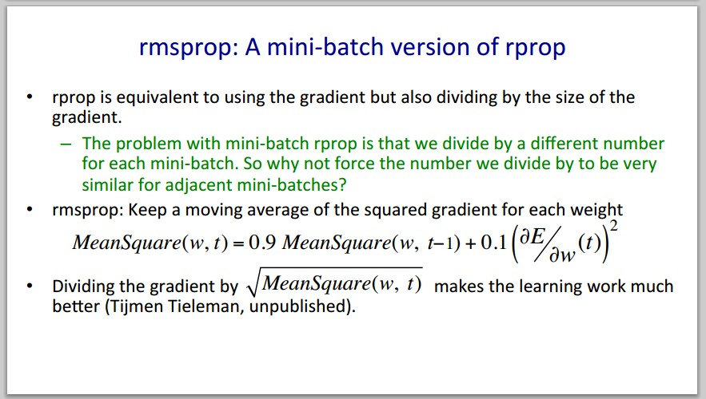
Introduced in a slide in Geoff Hinton’s Coursera class, lecture 6

Slide 61

Introduced in a slide in Geoff Hinton’s Coursera class, lecture 6
Cited by several papers as:

Slide 62
adagrad
rmsprop

Slide 63
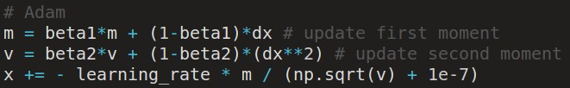
Adam update
[Kingma and Ba, 2014]
(incomplete, but close)

Slide 64
Adam update
[Kingma and Ba, 2014]
(incomplete, but close)
momentum
RMSProp-like
Looks a bit like RMSProp with momentum

Slide 65
Adam update
[Kingma and Ba, 2014]
(incomplete, but close)
momentum
RMSProp-like
Looks a bit like RMSProp with momentum

Slide 66
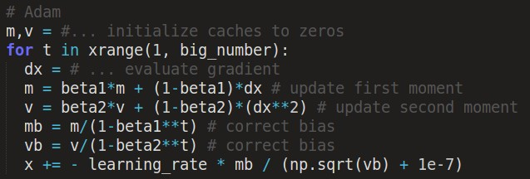
Adam update
[Kingma and Ba, 2014]
momentum
bias correction
(only relevant in first few iterations when t is small)
RMSProp-like
The bias correction compensates for the fact that m,v are initialized at zero and need some time to “warm up”.

Slide 67
SGD, SGD+Momentum, Adagrad, RMSProp, Adam all have learning rate as a hyperparameter.
Q: Which one of these learning rates is best to use?

Slide 68
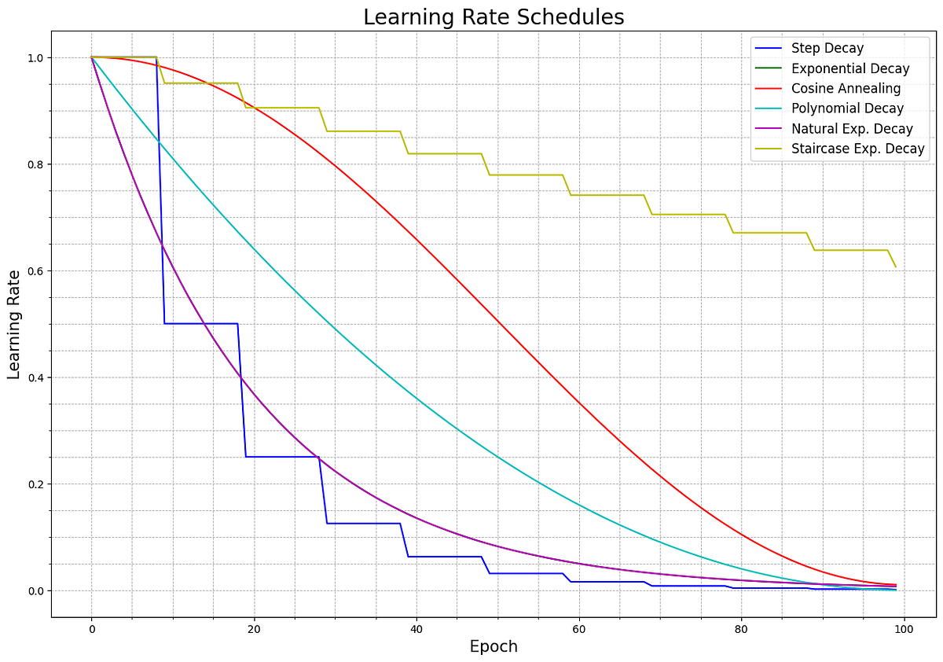

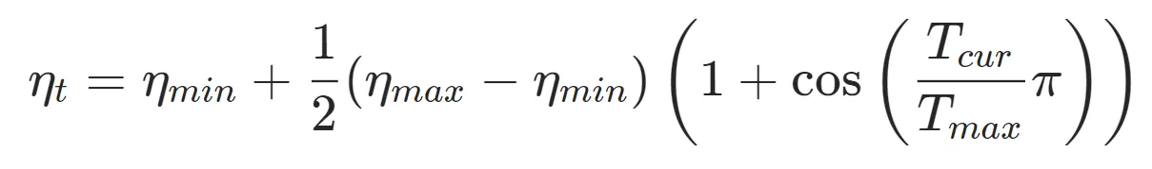
SGD, SGD+Momentum, Adagrad, RMSProp, Adam all have learning rate as a hyperparameter.
Learning rate decay over time
(LR Schedulers)!
Step decay:
e.g. decay learning rate by half every few epochs.
Exponential decay:
Cosine decay (Best):

Slide 69
Summary
Simple Gradient Methods like SGD can make adequate progress to an optimum when used on minibatches of data.
Second-order methods make much better progress toward the goal, but are more expensive and unstable.
Momentum: is another method to produce better effective gradients.
ADAGRAD, RMSprop diagonally scale the gradient.
ADAM scales and applies momentum.

Slide 70
The effects of different update formulas
(image credits to Alec Radford)

Slide 71
Questions?

